Slide 1
HEART DISEASE PREDICTION
BY ALICE CHANG
FOR IOD DATA SCIENCE & AI – P/T
14 August 2021

Slide 2
Agenda
Definition of Heart Disease
Stakeholders
Findings and outcome
Verify with test scores
Recommendations

Slide 3
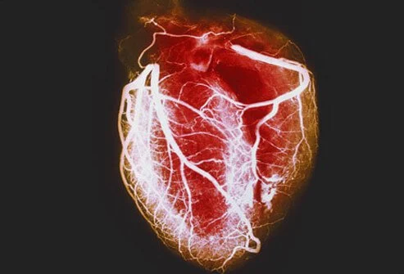
Medical Definition of Heart Disease
A heart muscle with blood vessels
Any disorder that affects the heart. Heart disease is synonymous with cardiac disease but not with cardiovascular disease which is any disease of the heart or blood vessels.

Slide 4
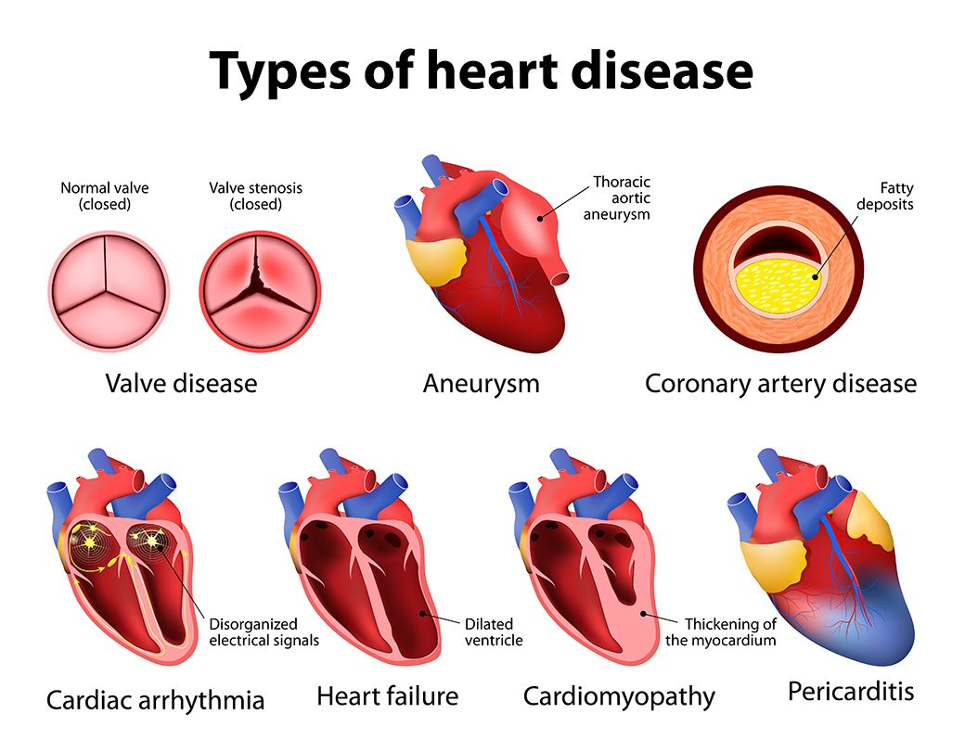
Examples of Heart Disease

Slide 5
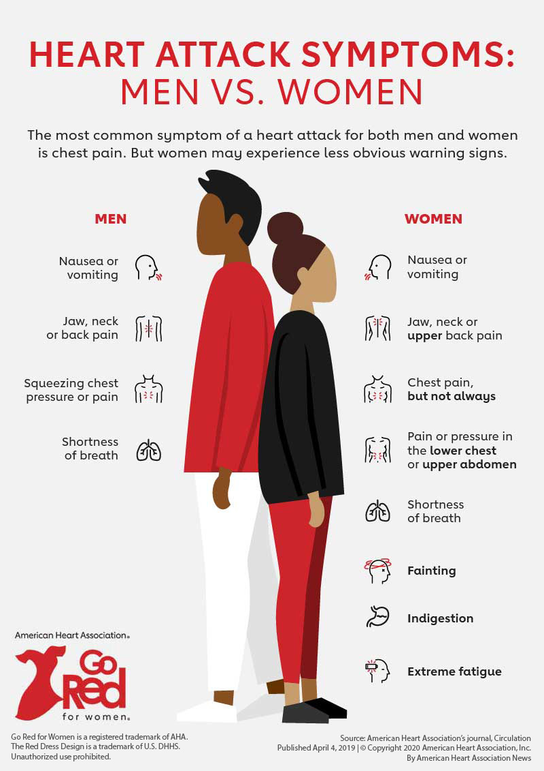
Symptoms of Heart Disease

Slide 6
Stakeholders
2 patients
Profile of patient 1:
Age 54, female. With symptoms
Profile of patient 2:
Age 65, male. No symptoms
Step 1
Collect data
Run tests
Step 2
Diagnosis
Verification
Step 3
Recommendations

Slide 7
Collecting data
We collect 13 essential datas of patients. There are 4 common indicators:
Items/Descriptions | Abrv. | Values
Chest Pain | cp | 1 = typical angina | 2 = atypical angina |  | 3 = non-anginal pain |  | 4 = asymptomatic
Heart rate | thalachh | Maximum heart rate
Slope of heart rate during exercise | slp | 1 = upsloping |  | 2 = flat |  | 3 = downsloping
Electrographic measure when at rest | restecg | 0 = normal | 1 = having ST-T wave abnormality |  |  | 2 = showing probable/ definite left ventricular hypertrophy by Estes' criteria

Slide 8
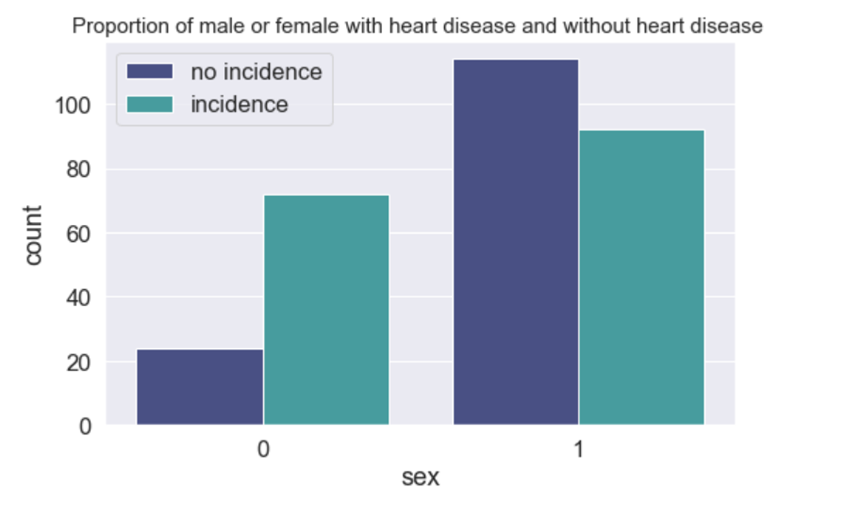
Females have a higher risk for heart disease
75% females (with heart disease)
vs
47% males (with heart disease)

Slide 9
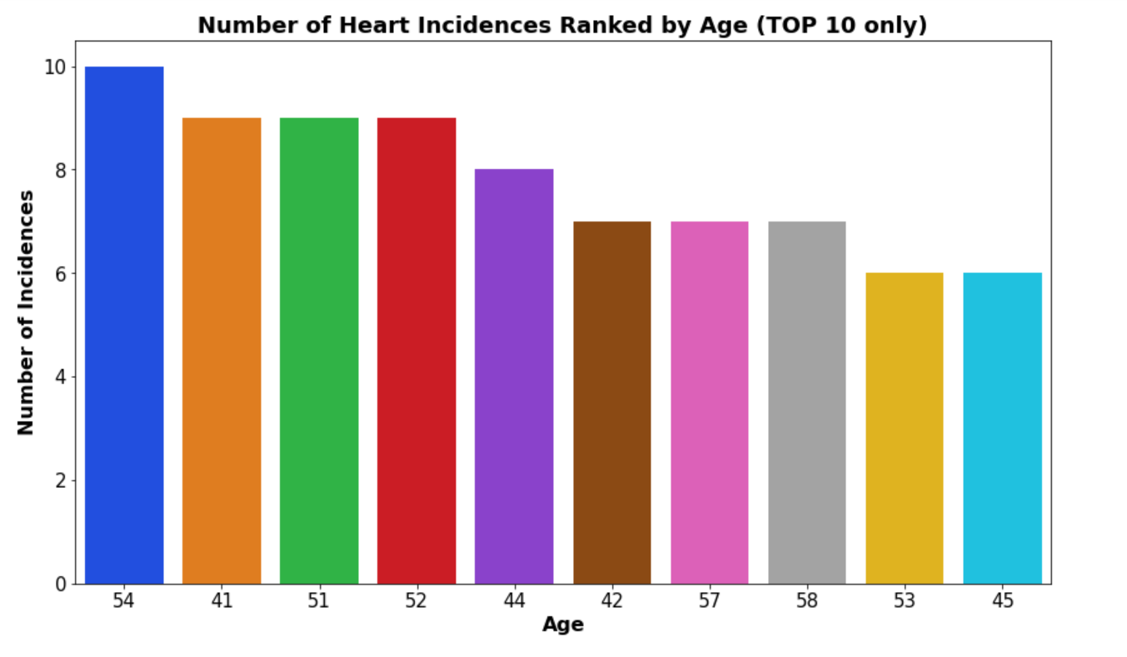
Top 10 ranking in terms of Age for heart disease
Symptoms of heart disease tend to begin occurring in patients who are in their 50s and 40s.
Patient 1 who is female and 54 years old with symptoms would stand a high chance of being diagnosed with heart disease.
Patient 2 is male and age of 65 with no prior symptoms may not have heart disease.

Slide 10
DIAGNOSIS
Logistic Regression model is used to predict the diagnosis.
 | Predicted (With heart disease) | Predicted (No heart disease)
Actual (heart disease) | 42 | 0
Actual (no heart disease) | 8 | 32
90% accuracy for overall prediction

Slide 11

Verify results with more test scores
Precision Score (84%) precision on prediction for those with actual heart disease.
Recall Score of 100% on actual condition and were predicted correctly.
F1 Score of 91.3% assesses the reliability of both Precision and Recall Scores.
Patient 1 who is female and 54 years old with symptoms has a 84% chance of having a heart disease.
Patient 2 is male and age of 65 with no prior symptoms will have a correct prediction of having no heart disease.

Slide 12

Recommendations
Patient 1 who is female and 54 years old with symptoms has a 84% chance of having a heart disease.
To seek 2nd medical opinions and continue to monitor their conditions.
Patient 2 is male and age of 65 with no prior symptoms will have a correct prediction of having no heart disease.

Slide 13
Acknowledgement
Source of data: University of California Irvine.

Slide 14
End of Presentation

